Slide 1
Welectricity
Developed by Ninja Hertz
NWEN 304
Tianfu Yuan (Tony) & John Armstrong
Notes:
John

Slide 2
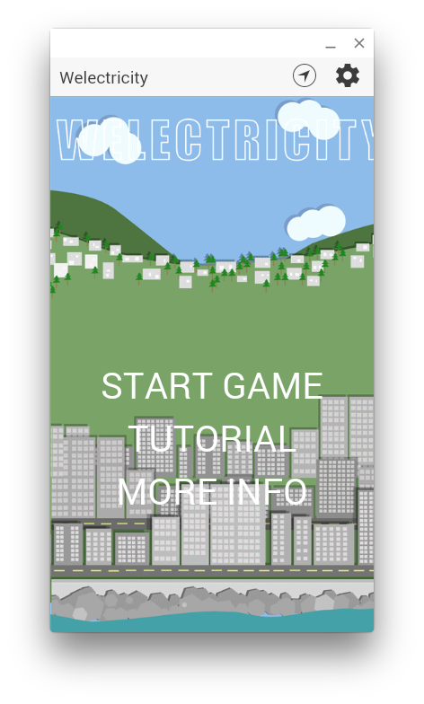
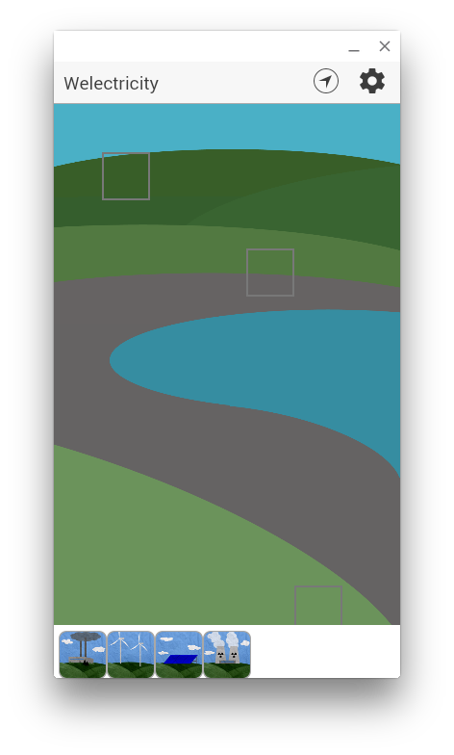
Current Game Screen
Notes:
Tony

Slide 3
Target user: 5 ~ 12 years-old children
Notes:
Tony

Slide 4
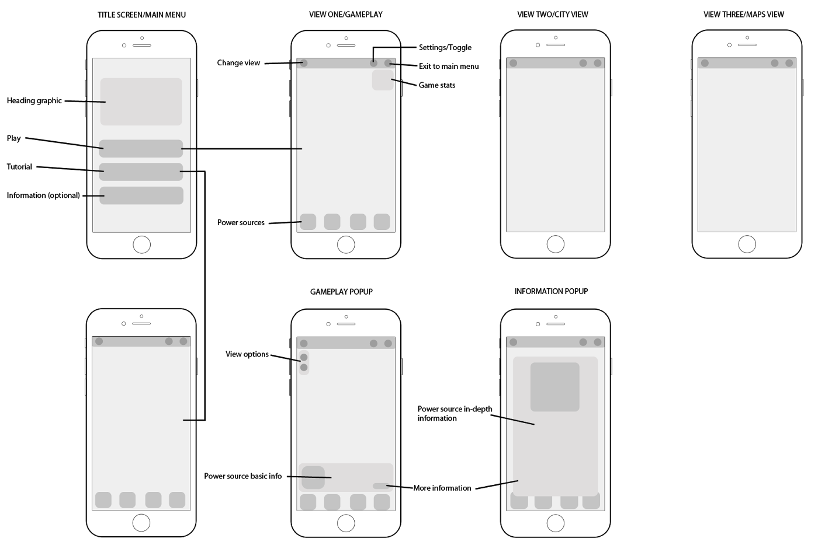
Notes:
Tony

Slide 5
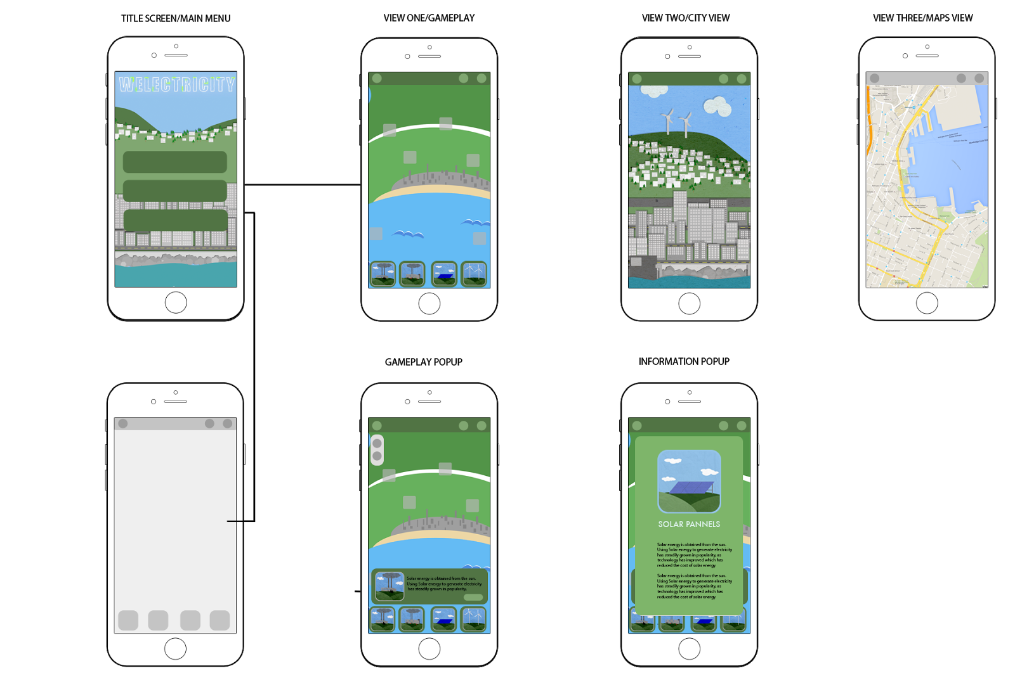
Notes:
Tony

Slide 6
Application Architecture
Client - Server Architecture
Client
User game interaction
User register/login
Save/load game data to/from server
Server
User login registration and authentication
Response data
Save/load data
Authentication
OAuth
Notes:
John
Client does most of the work
Server is mainly a RESTful database + authentication and some cheating detection

Slide 7

Front-end
Using the Ionic framework that is powered by AngularJS framework, combined with HTML, CSS and JavaScript to implement our App.
Dynamic web views
Data binding
Boiler plate code setup
Extend HTML
Server communication
Testable
Notes:
John
Use ionic framework to take care of all boiler plate code setup. e.g cordava leaves a lot to be desired (splash screen).
Angular has dynamic data binding so can add data to backend and it will update on front end. e.g Add more power plants

Slide 8
Back-end
User information
Username/password
E-mail address
Heroku
NodeJS
ExpressJS
Game data
Power plant data
Check score (no cheaters!)
Host
Notes:
John
Use heroku (free account)
NodeJS with expressJS

Slide 9
Database Design
Using Postgresql for our database.
Functions:
Store user registration/login data (hashed passwords)
Save/Load user game data
Game components (e.g power plants)
Limitations:
Max 10,000 rows
Max 20 concurrent connections
Notes:
John

Slide 10
Security Design
OAuth (if time permits)
Unique ID to each registered user.
Username & Hashed Password in database
Access via https (not http) when sending from app
Privacy
User email is not sent back to application once it is stored on server
Problems:
Encryption problem (https only to heroku)
Our app is FREE & NO ADS, so no such problem with credit card fraud issues.
Notes:
John

Slide 11
Reliability Design
Reduce the client app size
Try put “everything” on server -> Database keep update
Problems:
Compatibility on different Android devices (screen size)
iOS sandbox
Use of Macs to build app (Swift?)
Notes:
Tony

Slide 12
Scalability Design
Heroku allows to scale up by using dyno.
Problems:
Dyno cost and limitation
User control
Notes:
Tony

Slide 13
Testing
Manual user functional testing (against trello card)
Give it to primary school students to play with it, and then get feedback.
Main platform for testing is Android.
Pre-Alpha
Alpha
Beta
RC
Gold
Notes:
Tony

Slide 14
Demonstration Video Design
Highlights:
1080*1920 HD video by Canon
Filmed in ergonomics lab
Maybe wearing business attire
Shooting kids play our app
May go to school to doing our video
Notes:
Tony

Slide 15
Implementation
Our app is still under developing.
Next things we need to do:
Game play function
Google map display
Parallax dynamic power plant view
Data security
… (a lot more!)
Notes:
John

Slide 16
Responsibility (Engineers)
John:
Game engine (gameplay, stats, time…)
Server: save/load/user registration
Drag & Drop functions
Google maps game play
Server architecture
App architecture and git
Tianfu (Tony):
Server/Backend design
Power plant info & loading
Pages architecture: city view, extra information & credits

Slide 17
Responsibility (Designers)
Josh:
Title page design
Splash screen
Animations
Pop-up boxes
Typography
Research & Calculation
Nicola:
City view graphics
Parallax
Sound
Research & Calculation
Navigation
Colour scheme
Art director
Nicolas:
Gameplay images
Power plant icons
Log-in screen

Slide 18
Thank you!
Any questions?

